Slide 1
Chapter 10
Embedded Systems

Slide 2
Chapter outline
Examples of embedded systems
Microcontroller chips
I/O interfaces
Design example – reaction timer
Sensors and actuators
Design issues

Slide 3
What is an embedded system?
It is a computer system used for a specific application (such as monitoring/controlling), rather than for general-purpose computing
It is a reactive system in which the points in time at which various software routines are executed are determined by events external to the processor

Slide 4
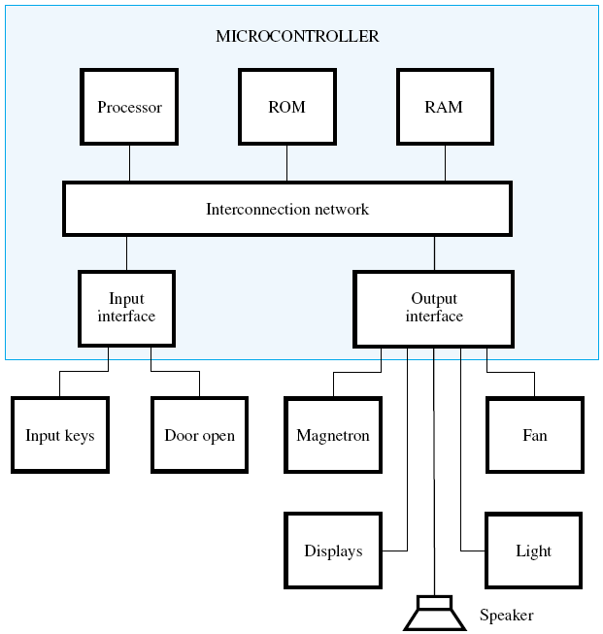
Microwave oven

Slide 5
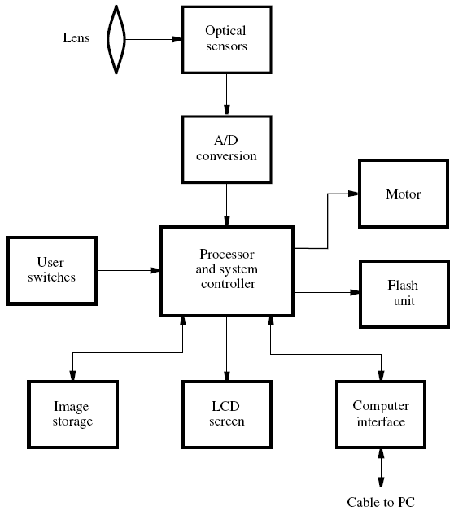
Digital camera

Slide 6
Implementation of an embedded system
There are two basic approaches:
Use a microcontroller chip, which has a predefined capability
Use the system-on-a-chip approach (which is discussed in Chapter 11)

Slide 7
Microcontroller chip
A microcontroller chip should be versatile enough to serve a wide variety of applications.
Therefore, a typical microcontroller chip comprises:
Processor core
Internal memory
Input/output ports
Timers
A/D and D/A conversion

Slide 8
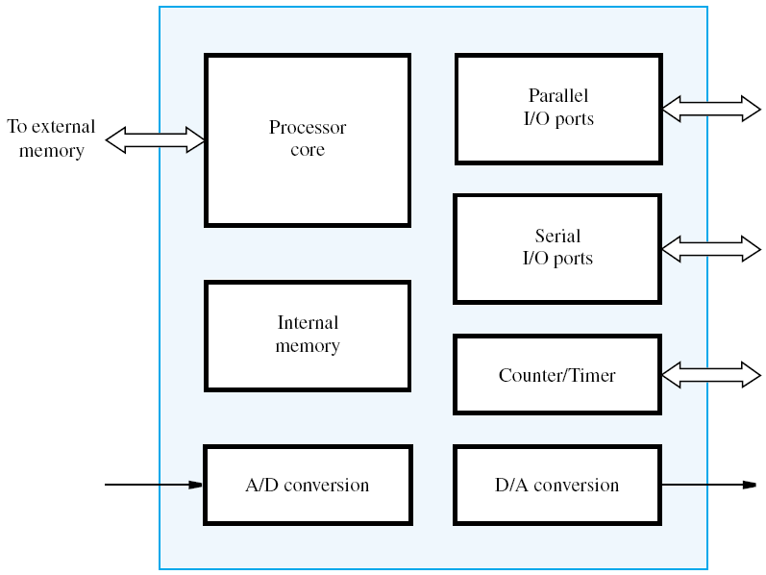
Block diagram of a microcontroller

Slide 9
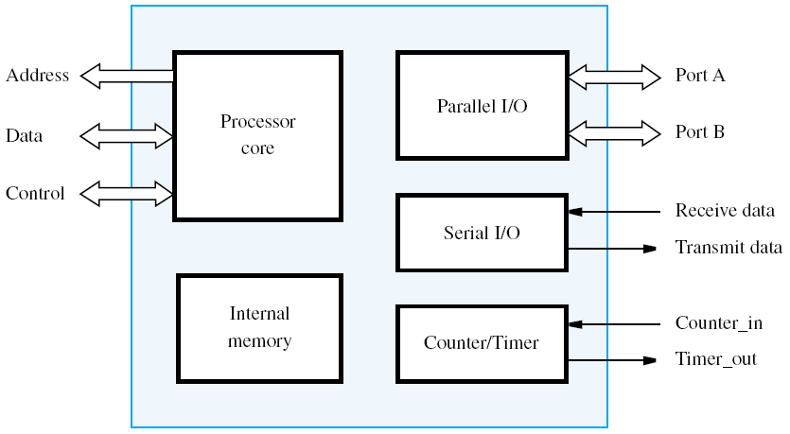
A more specific microcontroller example

Slide 10
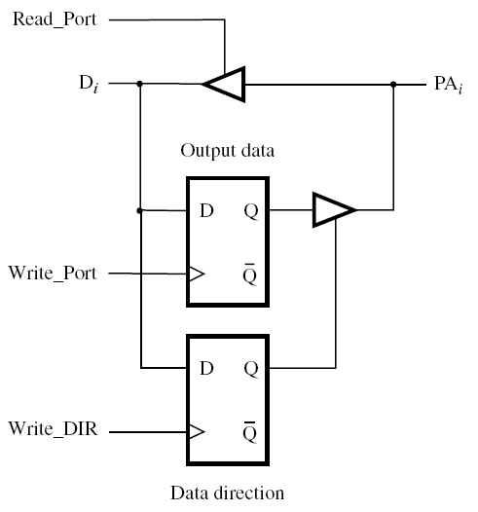
Access to one bit in port A
for example microcontroller

Slide 11
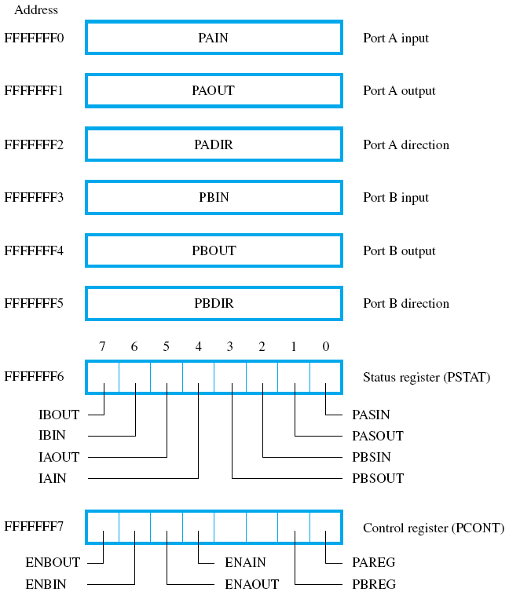
Parallel
interface
registers

Slide 12
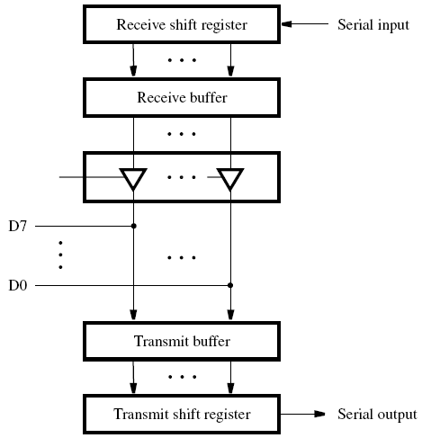
Receive and transmit structure of the serial interface

Slide 13
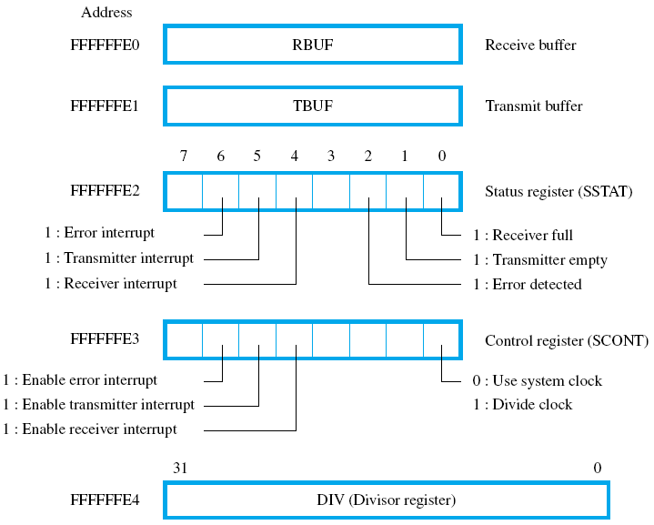
Serial interface registers

Slide 14
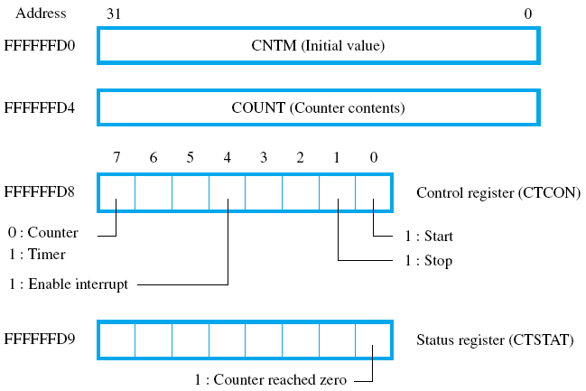
Counter/Timer registers

Slide 15
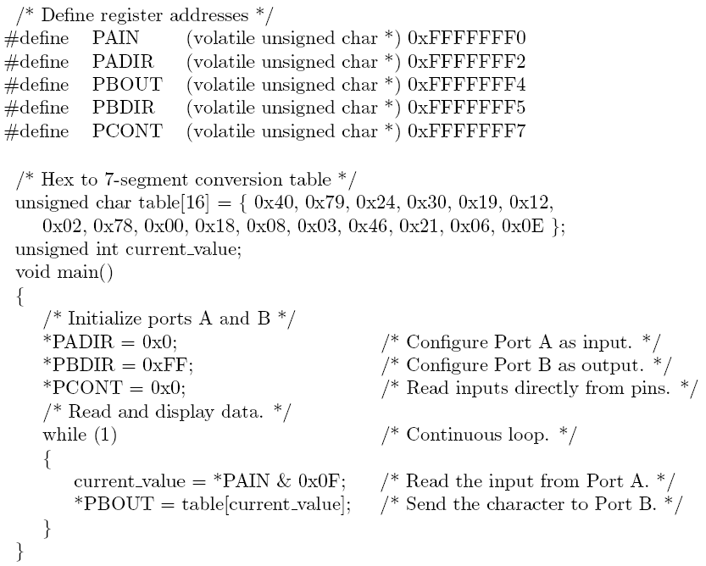
Figure10.10 – program for hex display

Slide 16
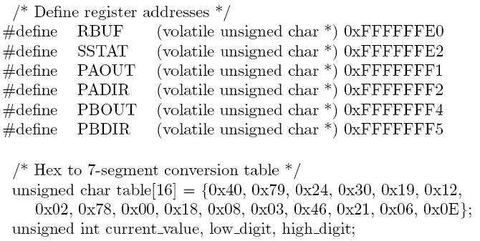
Figure 10.11 – program for serial input
Continued on the next slide

Slide 17
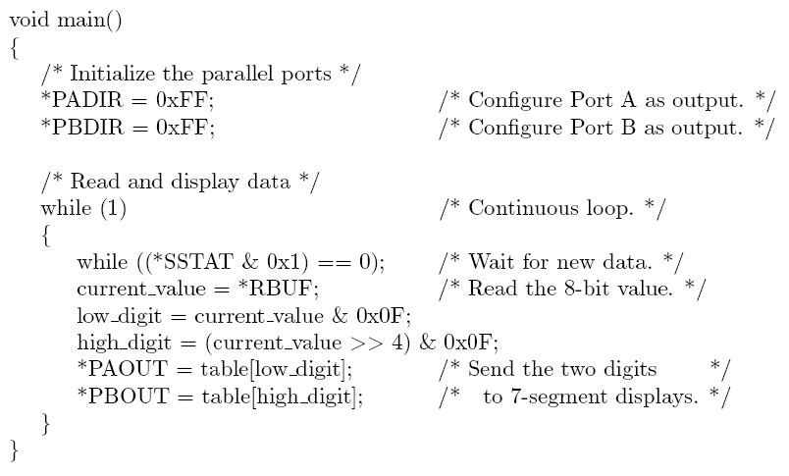
Figure 10.11 (continued)

Slide 18
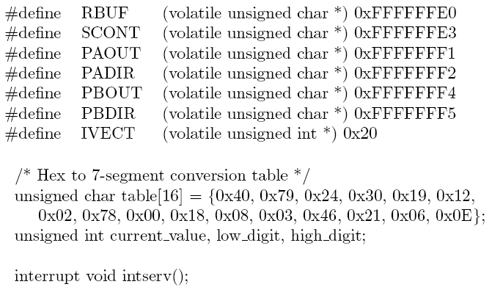
Figure 10.12 – program with interrupts
Continued on the next slide

Slide 19
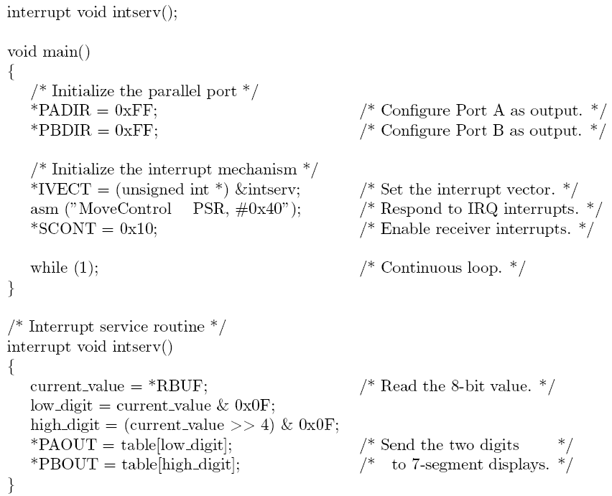
Figure 10.12 (continued)

Slide 20
A reaction-timer design example
An example of a reactive system
Measure the speed of response of a person to a visual stimulus
Determine and display the amount of time that the subject takes to observe that a light is turned on, and then turn it off by pressing a pushbutton switch

Slide 21
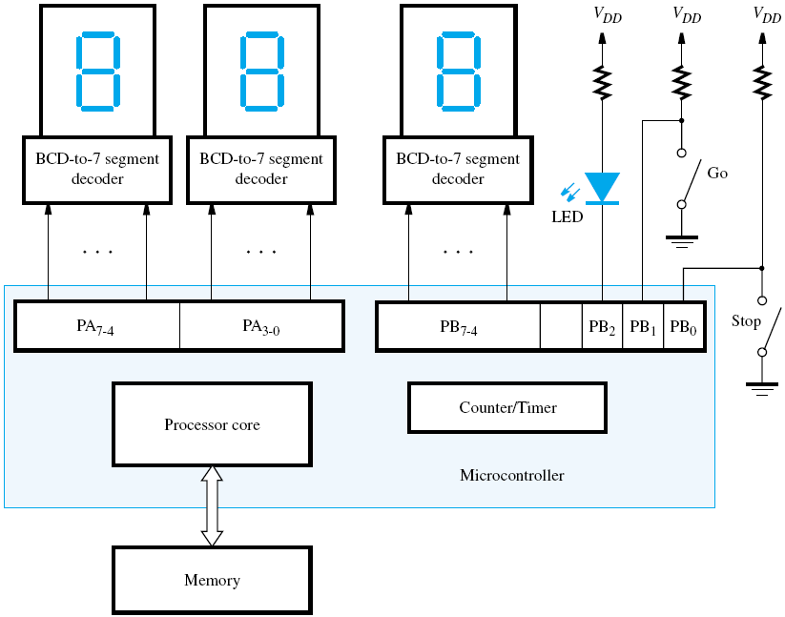
The reaction-timer circuit

Slide 22
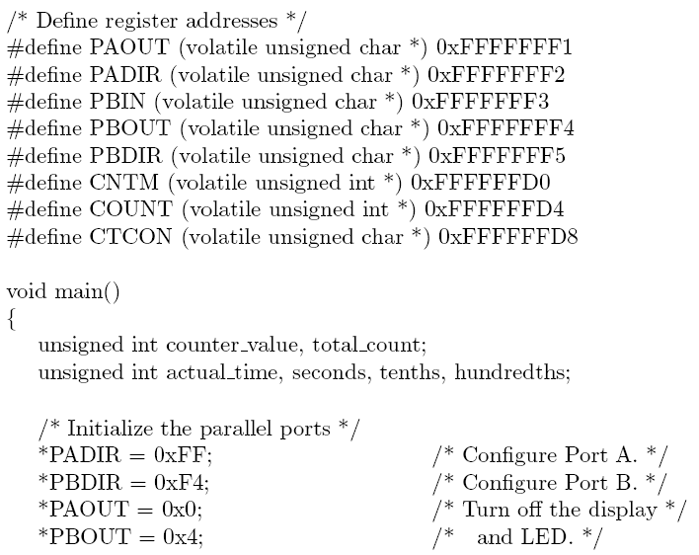
Figure 10.14 – program for reaction timer
Continued on the next slide

Slide 23
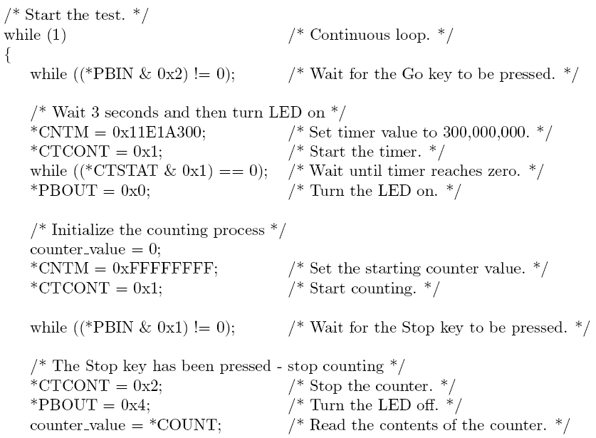
Figure 10.14 (continued)
Continued on the next slide

Slide 24
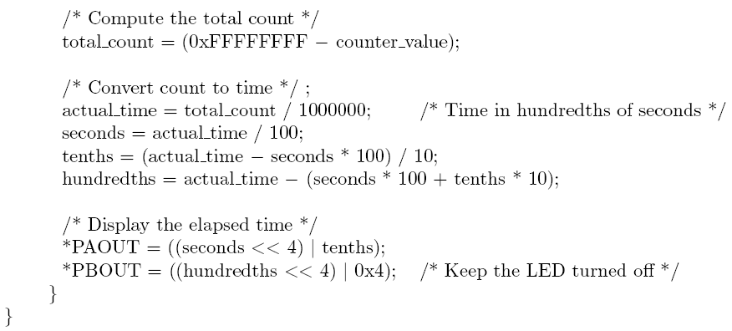
Figure 10.14 (continued)

Slide 25
Sensors and actuators
Needed to provide an interface between a computer and a mechanical system that has to be controlled
Sensors and actuators are often referred to as transducers
Sensors can be based on: position, pressure, temperature, speed, etc.
Actuators cause a mechanical component to move after receiving a command

Slide 26
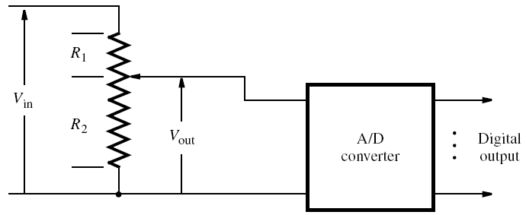
A sensor using a voltage divider

Slide 27
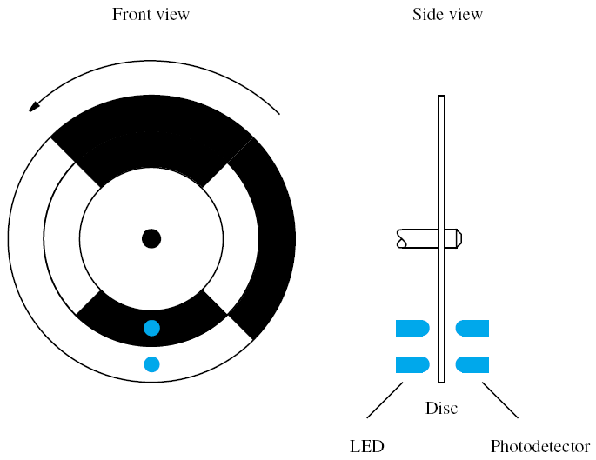
An optical position sensor

Slide 28
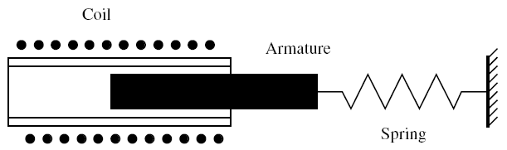
A solenoid actuator

Slide 29
Design issues when using a microcontroller
Cost - should be low
I/O capability - should provide a variety of resources
Size - 8-, 16-, or 32-bit processor core?
Power consumption - should be low
On-chip memory - size and type to suit application
Performance - important in some applications
(e.g., in a digital camera)
Development tools - CAD software

